Slide 1
Sport Management 101: Sport and Popular Culture [UCORE EQJS]
Embedding NACE Competencies in a Core to Career Assignment
Learning Objectives
Equity and Inclusion (the main premise of the course)
Career Development
Communication
Technology
Critical Thinking
Leadership
Professionalism
Notes:
What is the class?
SPORT IS A MICROCOSM OF OUR SOCIETY >> Uses sport as a platform to discuss issues of equity and inclusion.
Who takes it?
All majors – fulfills UCORE EQJS
Tasked by Core to Career Fellowship Group to create an assignment
In the assignment design, I had a couple of NACE Competencies in mind – Equity and Inclusion, Communication, Critical thinking but as the assignment took shape, I realized all the elements were incorporated!

Slide 2
Core to Career Assignment: The set up
34 Groups of 5: Used the class list from myWSU course page
Created an Excel sheet
Sorted students by area of study
There are 5 units in the class – each group was assigned 5 students
Assigned responsibilities and dates to each
I used part of one class to model the activity – as the facilitator

Slide 3
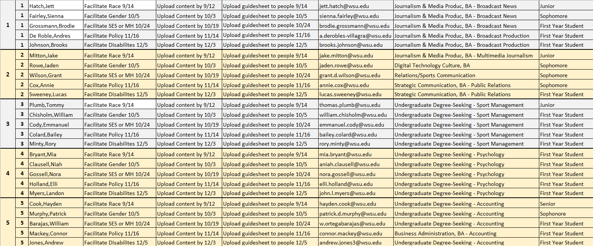
Notes:
Each student was assigned a FACILITATOR ROLE 1X (the table lists the day they are responsible). If they are not facilitating, then they are a PARTICIPANT 3x required out of 4
The Facilitator
Advanced students (by class standing) were assigned facilitator role first (modeling). Facilitators…
- find content that connects the unit topic to the career area of interest – then upload the content to the team’s Canvas space two days before class
- complete Worksheet 1 = a Guide Sheet for leading the group discussion with bullet points of content and open-ended questions
- they upload Worksheet 2 = a reflection about the activity by the end of the day they facilitate the discussion.
The Participants
- must be in class to earn activity points
- must upload the Participant Worksheet = a reflection about the experience
Facilitators earn 10 points and cannot drop the assignment.
Participants earn 8 points x 3 assignments (they can miss one); if they attend/engage in all 4 participant activities they earn extra credit.

Slide 4
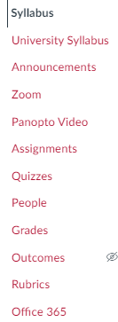
First: Facilitators find and post content based on the unit topic
Notes:
The content that facilitators source and provide to the group can be in a variety of formats: a podcast, investigative journalism, a documentary, statistics from the field, scholarly paper, etc.

Slide 5
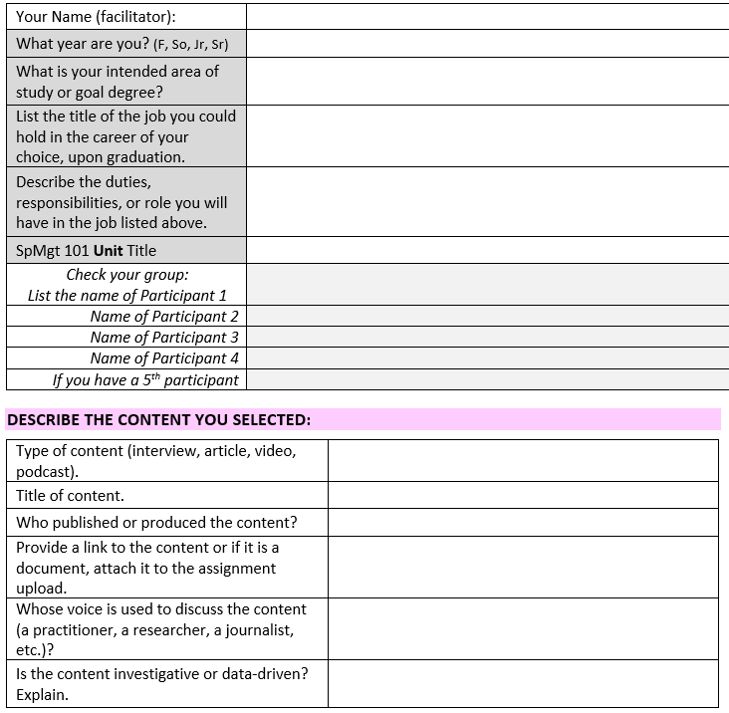
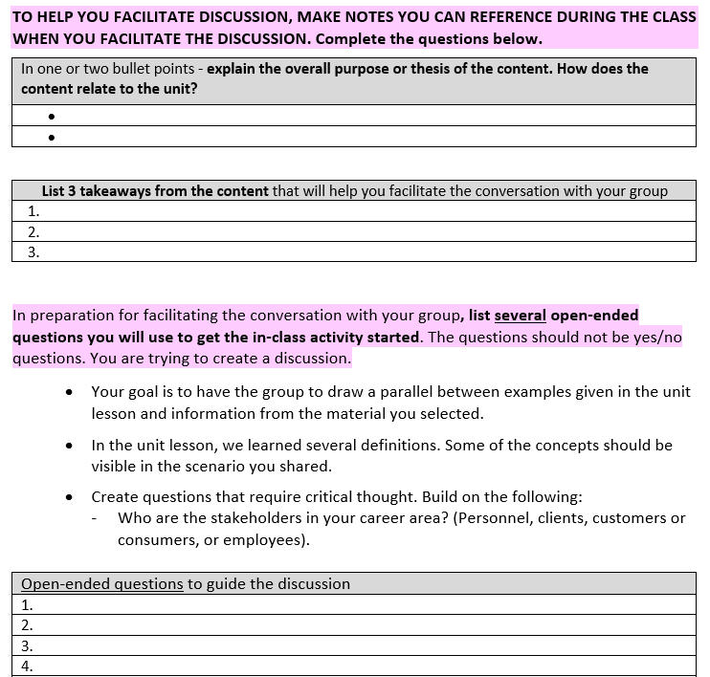
Second: Facilitators prepare to guide discussion – Complete Worksheet #1

Slide 6
Core to Career Activity Day
At the end of each unit…
Students sit with their assigned group by number.
Facilitators have already distributed content 2 days in advance AND completed Worksheet #1 before arriving at class.
Participants are expected to come to class having reviewed the content posted by the facilitators.
After 20-25 minutes of conversation, all students completed a reflection worksheet and upload it to Canvas.

Slide 7
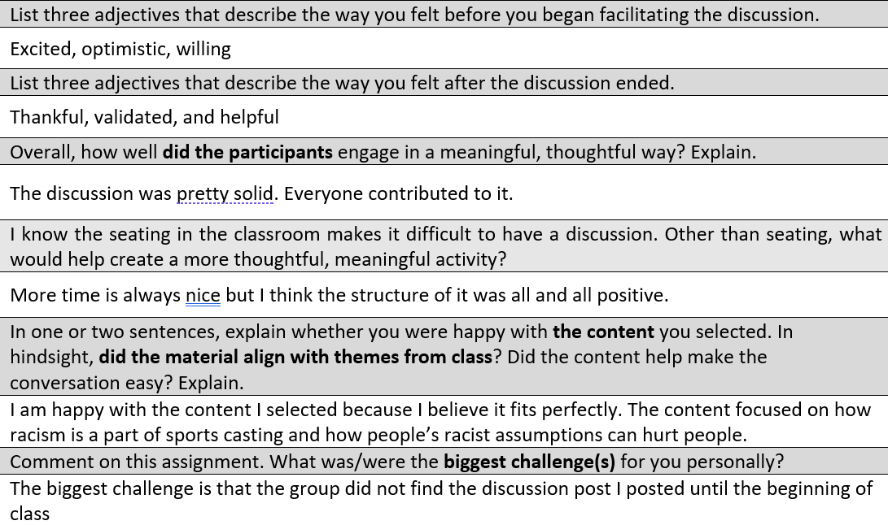
Facilitators Reflect After the Discussion – Complete Worksheet #2

Slide 8
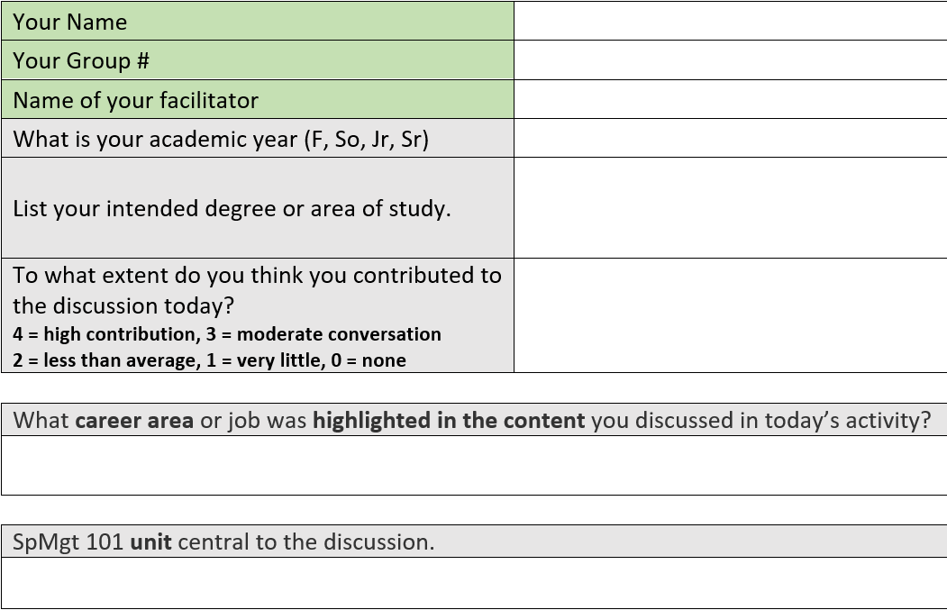
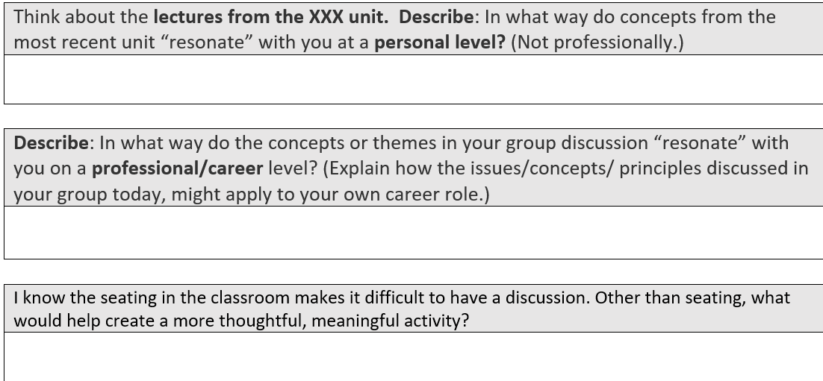
Participants’ Reflection
After the Discussion

Slide 9
Describe the extent to which you think your preparation for, or your participation in, the Core to Career activity adds value to the course.
On a scale of 1 to 7 (with 1 being 'absolutely not useful' - How valuable is the activity?)
Why is it useful or not?
Do you think it is worth keeping the activity?
Do you think it needs to be modified somehow?
I feel like facilitating and participation add a lot of value to the course. Because the class is so big it’s hard to actually participate [each class] so it’s nice to have a little group to do that with. I would say on a scale it’s a 6/7 for me because it’s cool seeing what different facilitators come up with and what people think about different topics. I think it’s worth keeping the activity because it adds variety to the course and it’s not too much work. The only thing I can think to modify is maybe give more of an outline with the questions. It was hard coming up with them and not quite knowing how to get others to talk about the content.
(Julia W. Fall 2023, Freshman, Marketing)

Slide 10
Challenges with the assignment
Front-loaded work – setting up the groups
Requires student accountability – and follow through
Tracking students who drop
Seating for 170 students (fixed vs moving seats)
Instructor printed copies of reflection worksheets for those without tech
Thinking critically is challenging when students don’t know the nuances of their chosen future career (they lack experience). Discussions can tend toward the hypothetical.

