Slide 1
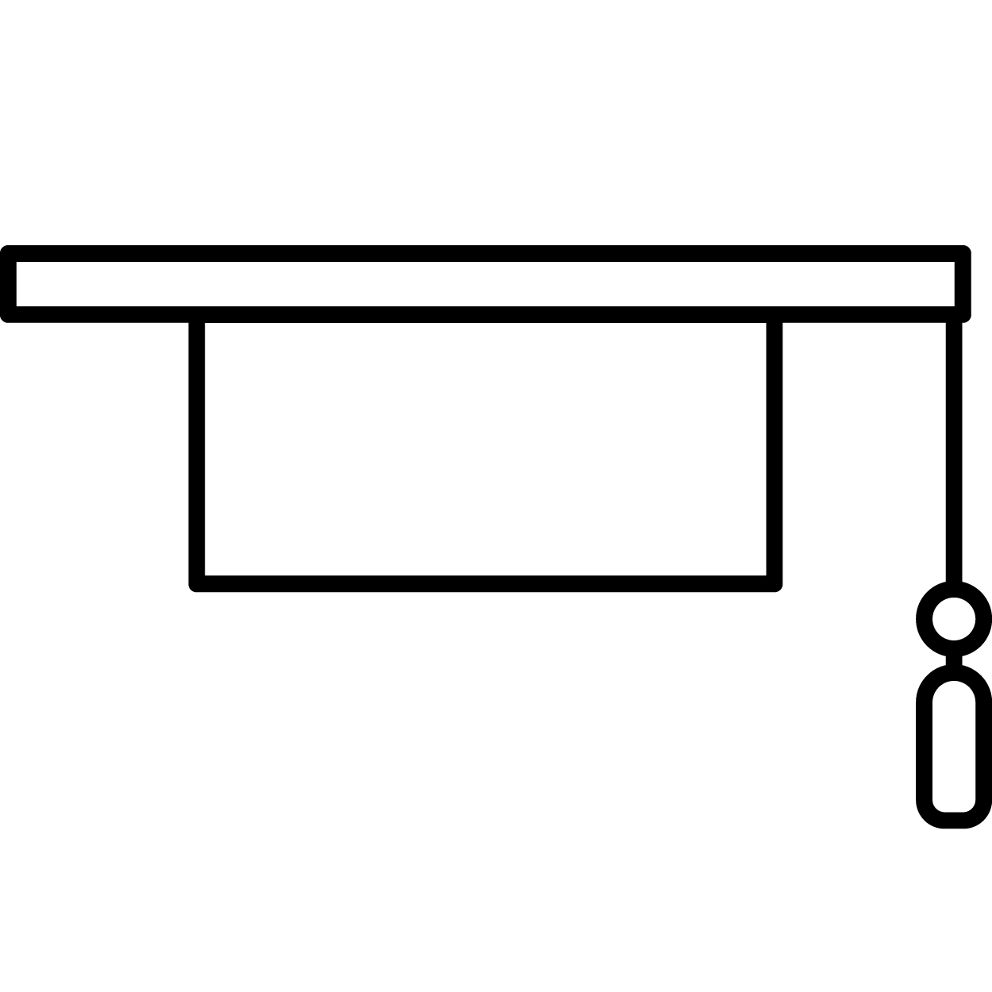
Applied Intervention: Communication
Group Interactions for Weekly Discussions
Group 1:
3 weeks
3 students per group
diversity of age, gender, location
Group 2:
5 weeks
3 students per group
diversity of age, gender, location, and academic interests
Group 3:
6 weeks
6 students per group
diversity of age, gender, location, and major
work completed by week nine
Discussion Structure
Submit a response to one of ten weekly prompts.
Respond to two group members’ submissions.
Organize a short Zoom meeting for the group to meet.
Discuss submissions and responses.
Respond to Discussion with what was learned in the group meeting.
Critical Thinking
Technology
Career and Self-Development
Professionalism
Communication
Teamwork
Equity & Inclusion
Leadership

Slide 2
Impact of Intervention on Student Learning
Week 2 Discussion
Prompt asked students to:
Provide a 250 to 300-word response to the prompt on the three types of myths.
Respond to the two other group members’ submissions with 25 to 50 words.
Complete the NACE Career Competencies Self-Evaluation.
Meet with members of the assigned group and discuss competencies and self-evaluation.
Determine what it means to be a proficient communicator.
Provide a unique definition of what it means to be a proficient communicator.
Week 15 Discussion
Prompt asked students to:
Complete the NACE Career Competencies Self-Evaluation.
Meet with groups to discuss the competencies and any changes to students’ self-evaluations.
Reflect on what it means to be a proficient communicator.
Reflect on the definition of a proficient communicator written in Week 2 and determine how your perspectives might have changed.

Slide 3
Interventions’ Impact on Student Learning
“We’ve had to work in small groups for this course. At first, I was honestly turned off by the idea. I’ve come to really appreciate it. I’ve never had an online learning experience as such before. I really feel like it has made me feel included as a student here at WSU, even as an online learner. It’s been an awesome way to get to know my fellow students and communicate with them in different ways than I’ve had to before.”
Career and Communication Critical Equity and Leadership Professionalism Teamwork Technology Self-Development Thinking Inclusion

